Slide 1


Revised Project Proposal (submitted on 20.02.2024)
on
Development of Equipment and Process of Jackfruit Suitable for Rural Area
Under Scheme of
S&T Scheme of KVIC
Agro Based & Food Processing Industry
(Fruit & Vegetable processing Industry)
Presented by
Dr. Kalyan Gayen (PI-1)
Email: kgayen123@gmail.com
&
Dr. Tridib Kumar Bhowmick (PI-2)
Email: tbhowmick@gmail.com
National Institute of Technology Agartala

Slide 2
Motivation & Objectives
Jackfruit available in large quantity (7th producer) in Tripura
Tripura is highest producer of Jackfruit on per hector basis
Cultivation of 1.34 million tones / year in Tripura (2022)
Processed tender jackfruit - Potential in micro scale sectors / farmers in rural area (Tripura)
Objectives:
Process development for removing browning effect of fresh cut tender jackfruit
Development of cheap process and packaging toolkit for long term preservation of tender jackfruits as per FASSI guideline
Estimation of nutritional values of processed and tender jackfruits
Training to the stakeholders (rural village) on processing and packaging of tender-jackfruits

Slide 3
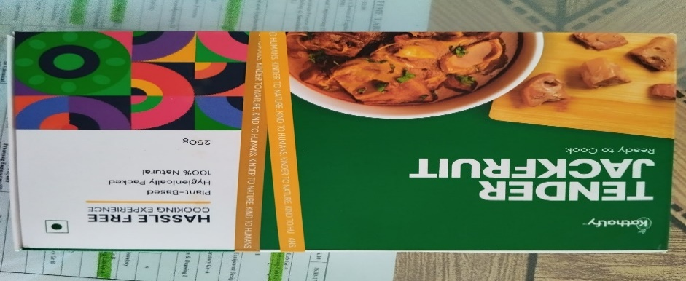
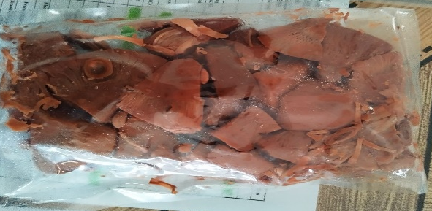
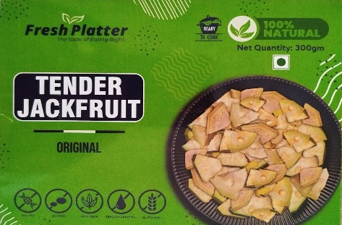
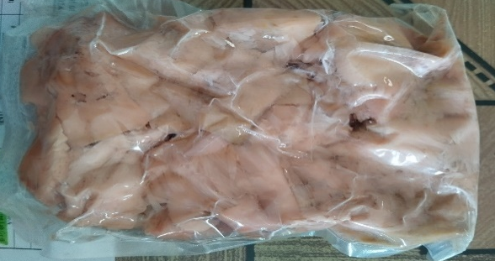
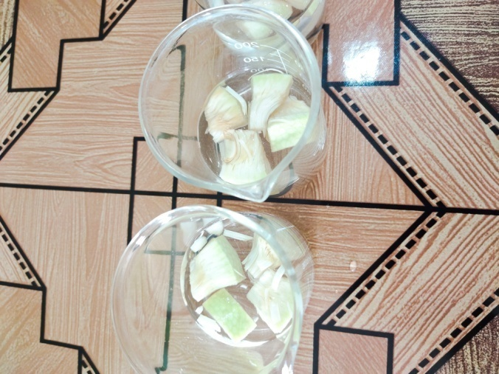
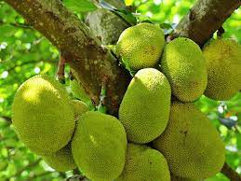
Objective 1 & Work Plan
Objective 1: Process development for removing browning effect of fresh cut tender-jackfruit
Issues: Browning Effect
Our Product (Lab Scale)
Processing technology
No Browning Effect

Slide 4
Objective 1 & Work Plan
Collection of Green Jackfruit
Work Plan for Objective 1:
Optimization of tender jackfruit processing at pilot scale to produce tender jackfruit with no browning
This technology will be developed by following the guideline of Food Safety and Standards Authority of India (FSSAI)
Washing with water
Removal of outer surface
Washing with salt solution
Cutting into pices of required size
Processing
Blancing of the cut jackfruit pices

Slide 5
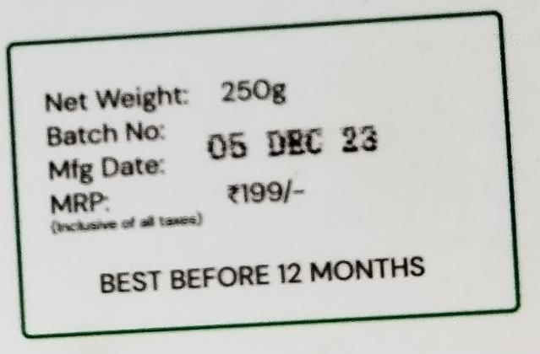
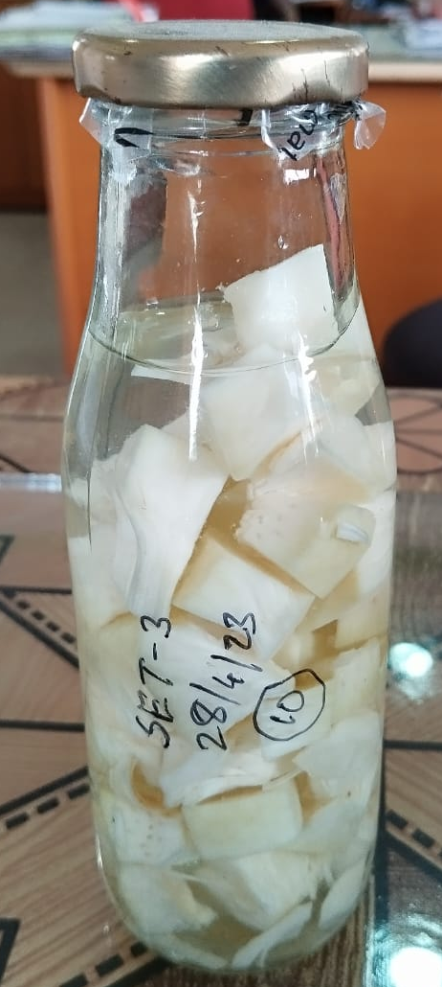

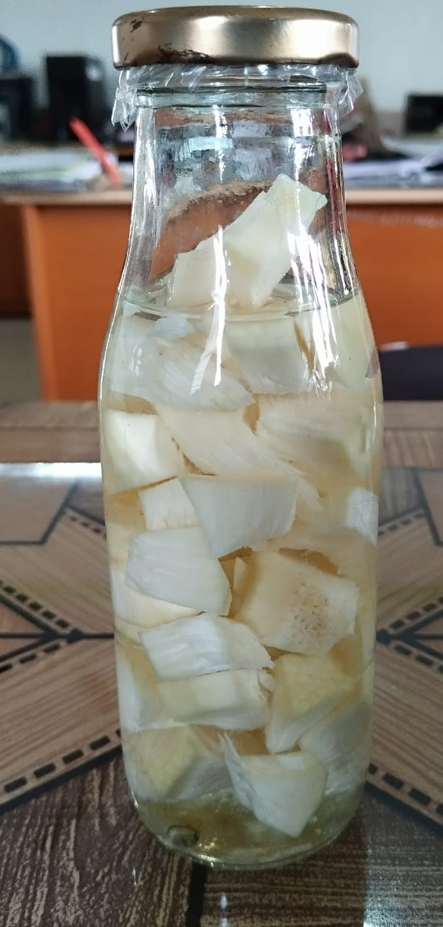
Objective 2 & Work Plan
Objective 2: Development of cheap process and packaging toolkit for long term preservation of tender jackfruits as per FASSI guideline
Products in Market Price: INR 800/kg
Processed Jackfruit
Best before 12 months
(Lab Scale)
Production Cost:
INR 200 /kg

Slide 6
Objective 2 & Work Plan
Work Plan for Objective 2:
Long term preservation of processed tender jackfruit as per FASSI guideline
Development of cheap packaging technique
Scale up the processing technology from Lab scale to pilot scale
Selection and testing of cheap tool-kits relevant to the rural area
Development of processing technology to start affordable Micro-scale business with capital cost with in 1-1.5 Lakhs
Products: Tender jackfruit ready to cook, Tender jackfruit Chunk and Tender jackfruit flour
Packaging of the cut jackfruits
Storing of packaged jackfruit

Slide 7
Objective 3 & Work Plan
Objective 3: Estimation of nutritional values of processed and tender-jackfruits
Work Plan for Objective 3:
Analysis nutritional values of packed processed jackfruit and raw jackfruits (e.g., carbohydrate, protein, fat, color, vitamin C, titrable acidity ) as per FASSI guidelines
Jackfruit | % of dry biomass
Carbohydrate | 35-45
Protein | 45-55
Lipid | 3-5
Ash | 2-3

Slide 8
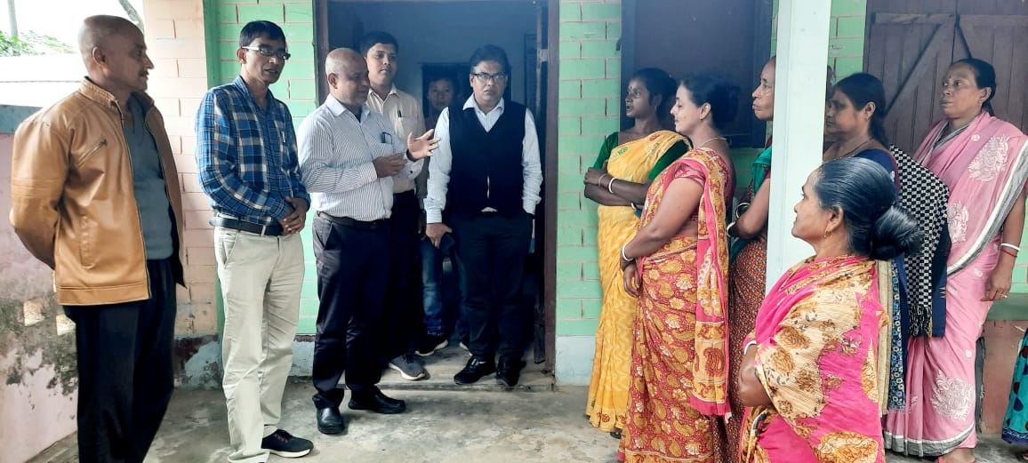
Objective 4 & Work Plan
Objective 4: Training to the stakeholders (rural village) on processing and packaging of tender-jackfruits
Work Plan for Objective 4:
Demonstration and training – stakeholders (rural village)

Slide 9
Deliverables
Agro-based product development utilizing the local resources (Processed Tender Jackfruit).
Economic development of the rural people
Employment generation in rural are
Generation of micro-scale business/ startup business
Training to the manpower

Slide 10
Financial budget (INR)
Head | Year 1 | Year 2 | Year 3 | Total
Non - recurring | 9,25,000 | 0 | 0 | 9,25,000
Recurring
Manpower | 2,64,000 | 2,64,000 | 3,03,600 | 8,31,600
Consumables | 2,50,000 | 2,00,000 | 1,50,000 | 6,00,000
Travel | 10,000 | 10,000 | 10,000 | 30,000
Training Programme | 0 | 25,000 | 50,000 | 75,000
Contingency | 50,000 | 50,000 | 50,000 | 1,50,000
Institute Over head @ 15% | 74,950 | 27,450 | 28,180 | 1,30,580
Total | 15,73,950 | 5,76,450 | 5,91,780 | 27,42,180

Slide 11
Dr. Kalyan Gayen
Academic Credentials
Degree | Institute | Year | Marks | NIRF
B. Tech (Chemical Engg.) | University of Calcutta | 1999 | 74.9% | 8-2022/ 12-2023
M. Tech (Chemical Engg.) | IIT Kharagpur | 2003 | 8.41/10 | 5-2022/ 6-2023
PhD (Chemical Engineering) | IIT Bombay | 2007 | 9.63/10 | 3-2022/ 3-2023
Post Doc | University of California Santabarbara, USA | 2007-2009 | - | QS: 134-2022/ 163-2023
Post PhD experience: 17 years
Teaching experience: 15 years
Industrial experience: ~ 1 year

Slide 12
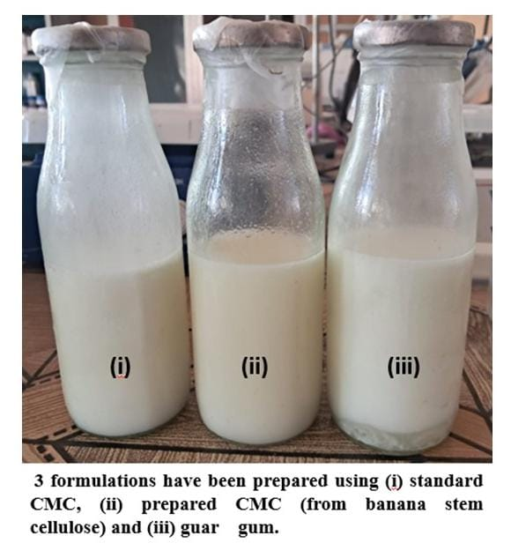
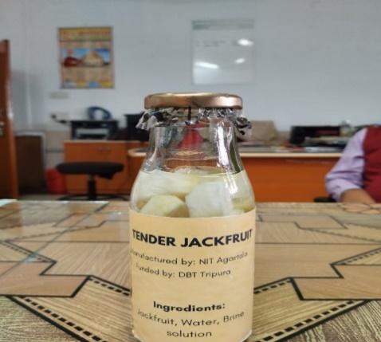
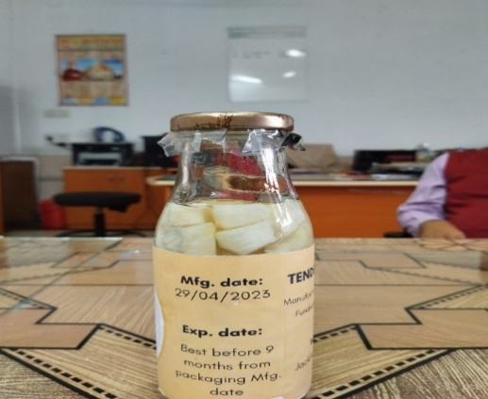
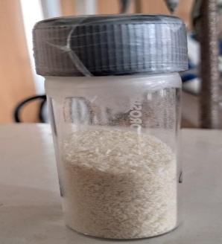
Dr. Kalyan Gayen
Achievements
Sponsored and consultancy projects:
Sponsored projects: 09 (DST, DBT, SERB, DRDO, DBT – Tripura)
Total amount: 356 Lakhs
Consultancy project: 01
Total amount: 7 Lakhs
Technology developed: 03
Research outputs:
Journal Publications: 48
Books: 02
Book Chapters: 14
Conferences: 49
PhD supervised: 04 as Principal Supervisor
PhD ongoing: 05 as Principal Supervisor
Citations: 2354
h-index: 22
i-10 index: 32

Slide 13
Dr. Tridib Kumar Bhowmick
Academic Credentials
Degree | Institute | Year | Marks | NIRF
B. Tech (Pharmacutical Tech.) | Jadavpur University | 1996 | 65% | 12-2022/ 4-2023
M. Tech (Biotechnology) | Jadavpur University | 1999 | 71% | 12-2022/ 4-2023
PhD (Chemical Engineering) | IIT Bombay | 2009 | 7.38/10 | 3-2022/ 3-2023
Post Doc | University of Maryland College Park, USA | 2007-2013 | - | QS: 152-2021/ 158-2022
Post PhD experience: 16 years
Teaching experience: 11 years
Industrial experience: ~ 2 year

Slide 14
Dr. Tridib Kumar Bhowmick
Achievements
Sponsored and consultancy projects:
Sponsored projects: 05 (DST, DBT, SERB, DRDO, DBT – Tripura)
Total amount: 133.5 Lakhs
Consultancy project: 01
Total amount: 7 Lakhs
Technology developed: 03
Research outputs:
Journal Publications: 40
Books: 02
Book Chapters: 10
Conferences: 30
PhD supervised: 02
PhD ongoing: 04
Citations: 1550
h-index: 18
i-10 index: 24

Slide 15
Thank you
for
Providing opportunity to present our revised proposal

